Slide 1
Progress Report 7-15-2024

Slide 2
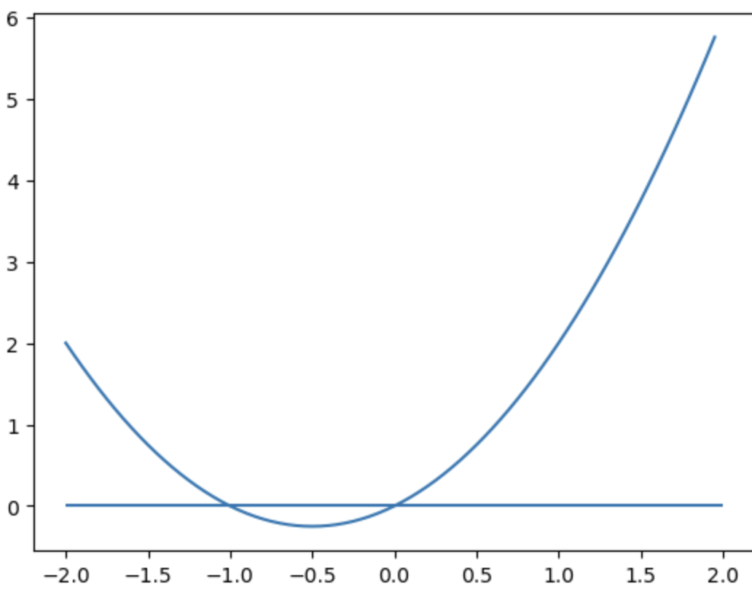
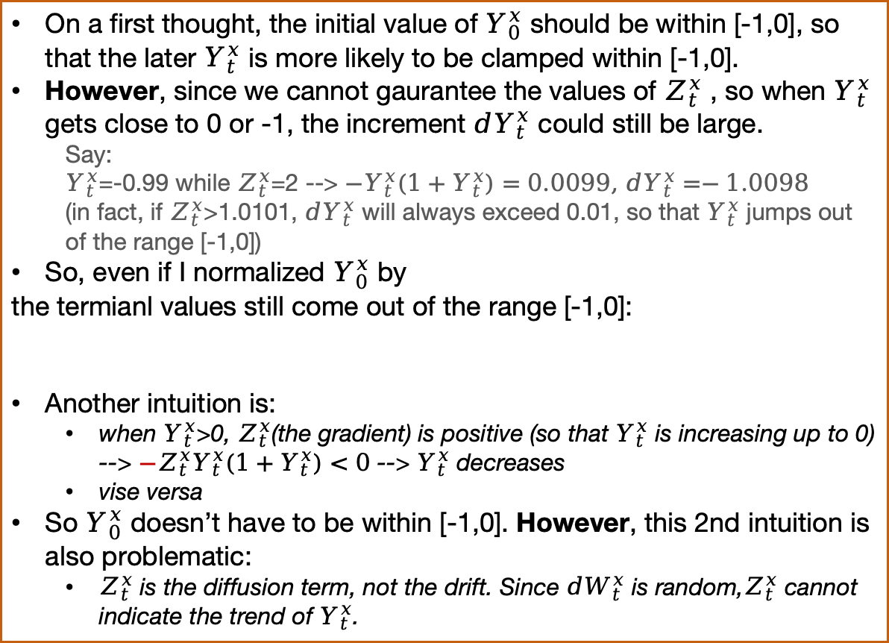


Problem 1
clamp trick:$dY_{t}^{x}=Z_{t}^{x}Y_{t}^{x}(1+Y_{t}^{x})dW_{t}$
Should be: $dY_{t}^{x}={−Z}_{t}^{x}Y_{t}^{x}(1+Y_{t}^{x})dW_{t}$ , in order NOT to change the sign.
How would it work??
On a first thought, the initial value of $Y_{0}^{x}$ should be within [-1,0], so that the later $Y_{t}^{x}$ is more likely to be clamped within [-1,0].
However, since we cannot gaurantee the values of $Z_{t}^{x}$ , so when $Y_{t}^{x}$ gets close to 0 or -1, the increment ${dY}_{t}^{x}$ could still be large.
Say:
$Y_{t}^{x}$=-0.99 while $Z_{t}^{x}$=2 --> ${−Y}_{t}^{x}(1+Y_{t}^{x})=0.0099,$ ${dY}_{t}^{x}=−1.0098$
(in fact, if $Z_{t}^{x}$>1.0101, ${dY}_{t}^{x}$ will always exceed 0.01, so that $Y_{t}^{x}$ jumps out of the range [-1,0])
So, even if I normalized $Y_{0}^{x}$ by
the termianl values still come out of the range [-1,0]:
Another intuition is:
when $Y_{t}^{x}$>0, $Z_{t}^{x}$(the gradient) is positive (so that $Y_{t}^{x}$ is increasing up to 0) --> ${−Z}_{t}^{x}Y_{t}^{x}(1+Y_{t}^{x})<0$ --> $Y_{t}^{x}$ decreases
vise versa
So $Y_{0}^{x}$ doesn’t have to be within [-1,0]. However, this 2nd intuition is also problematic:
$Z_{t}^{x}$ is the diffusion term, not the drift. Since ${dW}_{t}^{x}$ is random,$Z_{t}^{x}$ cannot indicate the trend of $Y_{t}^{x}$.
$$Y_{t}^{x}(1+Y_{t}^{x})$$
So, maybe we should not use this clamp directly, but with the help of yx_tilde.

Slide 3
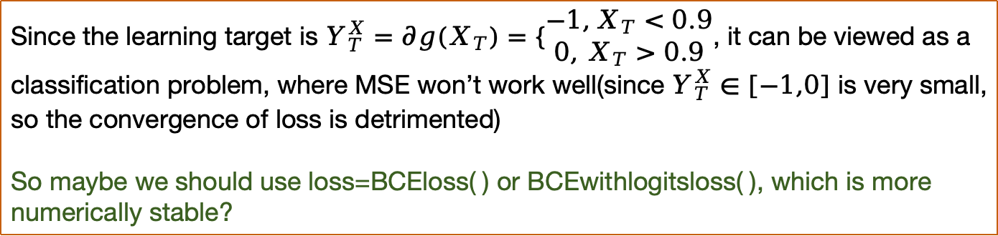
Problem 2
Loss function: MSE or Binary_cross_entopy?
Since the learning target is $Y_{T}^{X}=∂g(X_{T})=\left\{\begin{aligned}−1,X_{T}<0.9 \\ 0, X_{T}>0.9\end{aligned}\right.$, it can be viewed as a classification problem, where MSE won’t work well(since $Y_{T}^{X}∈[−1,0]$ is very small, so the convergence of loss is detrimented)
So maybe we should use loss=BCEloss( ) or BCEwithlogitsloss( ), which is more numerically stable?

